Slide 1
- Ph.D. Defense -
Runtime Support for Irregular Computations in MPI-Based Applications
Xin Zhao (xinzhao3@illinois.edu)
Department of Computer Science, University of Illinois at Urbana-Champaign
Mathematics and Computer Science Division, Argonne National Laboratory
April 1st, 2016
Thesis committee:
William D. Gropp (chair, UIUC), Laxmikant V. Kalé (UIUC),
Marc Snir (UIUC), Pavan Balaji (Argonne National Laboratory)

Slide 2
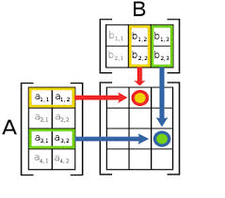
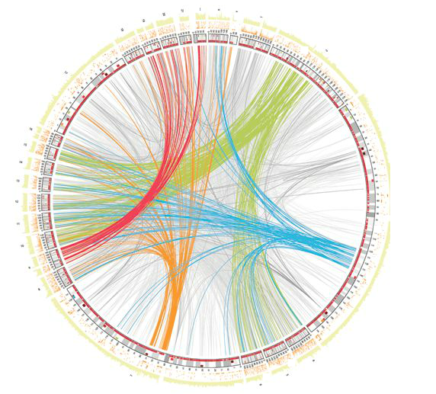
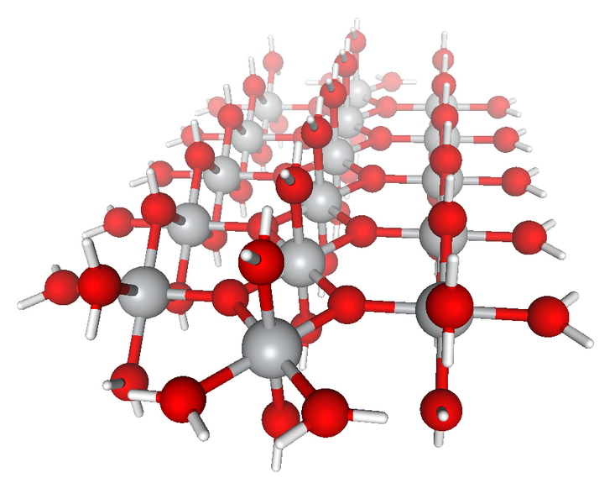
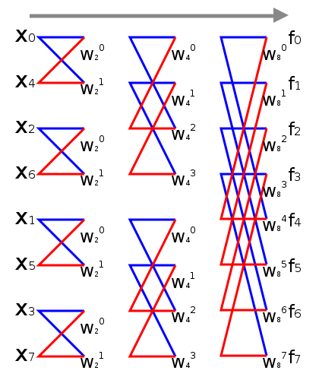
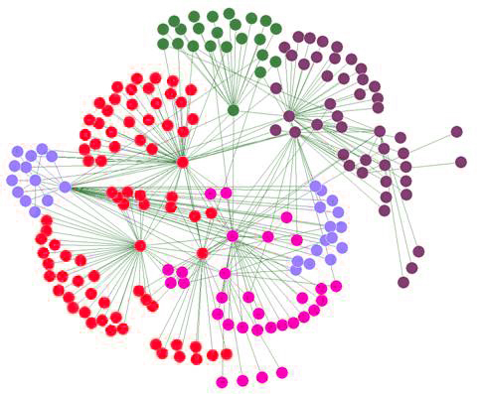
Irregular Computation
“Traditional” applications
Organized around regular data structures: dense vectors or matrices
Regular data movement pattern, use MPI SEND/RECV or collectives
More local computation, less data movement
Example: stencil computation, matrix multiplication, FFT
Irregular applications
Organized around graphs, sparse vectors, more “data driven” in nature
Data movement pattern is irregular and data-dependent
Growth rate of data movement is much faster than computation as system size / problem size grows
Example: social network analysis, bioinformatics
“New” irregular applications
Increasing trend of applications moving from regular to irregular computation model, due to reasons of computation complexity, power consumption, etc.
Example: sparse matrix multiplication

Slide 3


Application Examples
Social network analysis
Graph algorithms used for finding connections among people
Genome assembly: SWAP-Assembler^{[1]}
Current sequencing technology reads many small fragments (“reads”)
Reconstruct long DNA sequences by merging many small fragments
Fundamental operation in assembler: search for overlapping of reads (send query read to remote side; search through entire database on that node; return resulting read)
Sequencing
CCT
AGTTCCCTGGAACCGTGAC…
break into
small “reads”
DNA Samples
Reads
AGT
represent reads as
De Bruijn graph
Assembly
search & merge
overlapping reads
Water (H₂O)²¹
GGAAC
TTC
CTGGA
AGT
GTT
TCC
AGTTC
GAG
CCG
remove erroneous links
output long contigs
AGTTCCCTGGAACCGTGA
[1] Meng, Jintao, et al. "SWAP-Assembler: scalable and efficient genome assembly towards thousands of cores." BMC bioinformatics 15.Suppl 9 (2014)
AGTTCCCTGGAACCGTGA
Notes:
Genome assembly --- a sub-area of bioinformatics

Slide 4
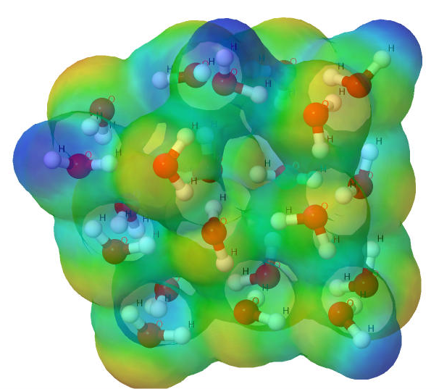
Quantum Chemistry Application: NWChem ^{[2]}
High performance computational chemistry application suite
Quantum level simulation of molecular systems
“Fetch-Compute-Accumulate” with sparse matrices
(H₂O)₂₀
get data
accumulate data
get data
accumulate data
DGEMM
DGEMM
local buffer on rank 0
local buffer on rank 1
[2] M. Valiev, E.J. Bylaska, N. Govind, K. Kowalski, T.P. Straatsma, H.J.J. van Dam, D. Wang, J. Nieplocha, E. Apra, T.L. Windus, W.A. de Jong, "NWChem: a comprehensive and scalable open-source solution for large scale molecular simulations" Comput. Phys. Commun. 181, 1477 (2010)

Slide 5
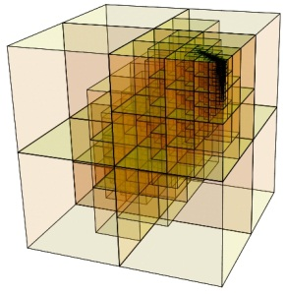
Traditional Regular Dense Computation vs. Irregular Sparse Computation
=
*
=
*
TILING
?
=
*
=
*
Can use traditional bulk synchronous parallel model
Outstanding message are regular, every process knows who to send to / receive from
Data distribution is no longer even, sparse matrices are used
Needs an one-sided model to fetch the data to local, compute, and write data to remote side
Massive outstanding messages are sent out, process does not know who to receive from

Slide 6
Main Concerns of MPI with Irregular Applications
MPI: industry standard communication library for high performance computing. Can MPI serve as a suitable runtime system for irregular applications?
Challenges:
Scalability: can MPI runtime be scalable when running irregular application with large problem size and on large scale?
Communication semantics: can MPI library absorb a mechanism of integrating data movement and computation?
Graph 500 strong scaling[*]
(2²² vertices)
data process
execution process
data and execution process
node 2
node 0
node 1
node 0
node 1
node 0
node 1
Graph 500 weak scaling[*]
(2¹⁹ ~2²⁹ vertices)
integrating data and computation
[*] Run on “Fusion” at ANL: 320 nodes, 36GB memory per node, 8 cores per node, Mellanox InfiniBand QDR interconnect
Notes:
MPI gains great success on HPC application, however, since it is a communication library originally designed for regular applications
People rise the concern that…

Slide 7
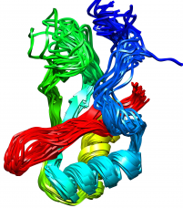

Research Goal
Study MPI’s suitability to irregular applications
Find out where MPI would lie on the spectrum of suitability
Influence future MPI implementations and standards to understand the implications of irregular applications
Propose what if anything needs to change to efficiently support irregular applications
irregular applications
?
MPI?
completely suitable
not suitable at all

Slide 8
Plan of Study
irregular applications
MPI runtime
MPI standard
Addressing scalability and performance limitations in massive asynchronous communication
Task 1: Tackling scalability challenges in MPI one-sided communication
Task 2: Scalable Virtual Connection Objects Initialization
Task 3: adaptive issuing strategy for MPI one-sided communication
Integrated data and computation management
Task 4: Generalized MPI-interoperable AM framework (MPI-AM)
Task 5: Optimizing MPI-AM for different application scenarios
Task 6: Asynchronous processing in MPI-AM
Notes:
The plan of study consists two parts:
In the first part, we propos improvements to MPI runtime for irregular applications, specifically, …
In the second part, we propose improvements to MPI standard for data-driven computations, specifically, …

Slide 9
Background: MPI-3 One-Sided Communication (MPI RMA Interface)
One-sided communication model: decouple data movement with process synchronization
Data is moved without synchronizing with remote side
Each process expose a memory region for remote accesses
Other processes can directly access that memory
Sender
Receiver
Origin
Target
Delay happened on receiver causes sender delayed
DELAY
MPI_SEND
Delay happened on target does not affect origin
MPI_PUT
DELAY
MPI_GET
MPI_RECV

Slide 10
Background: MPI-3 RMA Window Creation
Target process needs to declare a memory area (window) which is remotely accessible
Process 0
Process 1
Process 2
Process 3
Private
Memory
Private
Memory
Private
Memory
Private
Memory
window
window
window
window
Private
Memory
Private
Memory
Private
Memory
Private
Memory
Four models to create a window:
MPI_Win_create
User already has an allocated buffer that you would like to make remotely accessible
MPI_Win_allocate
User wants to create a buffer and directly make it remotely accessible
MPI_Win_create_dynamic
User does not have a buffer yet, but will have one in the future
User may want to dynamically add / remove buffers to / from window
MPI_Win_allocate_shared
User wants multiple processes on the same node share a buffer

Slide 11
Background: MPI-3 RMA Data Movements
RMA allows one process (origin process) to specify all parameters for both the origin and destination (target process)
Basic operations: PUT, GET
Atomic operations: ACC (accumulate), GACC (get and accumulate),
FOP (fetch and op), CAS (compare and swap)
Accumulate-like operations: ACC, GACC, FOP
origin
target
origin
target
origin
target
origin
target
process
window memory
+, -
+, -
PUT
GET
ACC
GACC, FOP, CAS

Slide 12
Background: MPI-3 RMA Synchronization modes
Rank 0
Rank 1
Rank 2
Rank 0
Rank 1
Win_fence
Win_fence
Win_fence
Win_post
PUT
PUT
Win_start
ACC
PUT
Win_fence
Win_fence
Win_fence
CAS
PUT
ACC
GET
Win_complete
Win_wait
Win_fence
Win_fence
Win_fence
Active Target mode: Fence
Active Target mode: Post-Start-Complete-Wait
Rank 0
Rank 1
Rank 0
Rank 1
Rank 2
Win_lock
Win_lock_all
PUT
PUT
GET
Win_flush
Win_flush_all
GET
FOP
GACC
Win_flush_local
Win_unlock
Win_flush_local_all
Win_unlock_all
Passive Target mode: Lock-Unlock
Passive Target mode: Lock_all-Unlock_all

Slide 13
- Subtopic 1 -
Addressing Scalability and Performance Limitations in Massive Asynchronous Communication
[Submitted to ICS’16] Addressing Scalability Limitations in MPI One-Sided Communication. Xin Zhao, Pavan Balaji, William Gropp.
[EuroMPI’12] Adaptive Strategy for One-sided Communication in MPICH2. Xin Zhao, Gopalakrishnan Santhanaraman, William Gropp.
[EuroMPI’11] Scalable Memory Use in MPI: A Case Study with MPICH2. David Goodell, William Gropp, Xin Zhao, Rajeev Thakur.

Slide 14
Background: Survey of RDMA Capabilities on Modern Networks
MPI_Win_create (base_addr, …, scaling_unit_size, …, &win)
Window address calculation
“HW-addr”: hardware accepts absolute address; runtime needs to maintain O(P) base addresses and sizes of scaling unit in order to translate offset (in scaling units) to absolute address
“HW-offset”: hardware accepts offset (in bytes); runtime needs to maintain O(P) sizes of scaling unit in order to translate offset (in scaling units) to absolute address
“HW-scaled-offset”: hardware accepts offset (in scaling units), runtime does not need to maintain any metadata (expected from future network)
MPI_Put (…, target_rank, offset_in_scaling_units, …, win)
MPI Runtime
What argument can be accepted by network?
HW_Put
(network interface)
locate absolute address

Slide 15
Background: Survey of RDMA Capabilities on Modern Networks (Cont’d)
Remote protection keys: for security concerns, target side generates a protection key for its own memory, only ones that own the key can directly access the memory region on target
Remote side notification: a notification is generated on target side when RDMA operation is completed on that target
Survey summary
Network | Window calculation | Protection keys | Remote notification
InfiniBand | HW-addr | Yes | PUT
Portals-4 | HW-offset | No | PUT / GET
Tofu | HW-addr | No | PUT / GET
IBM BG/Q | HW-offset | No | PUT
Cray Aries | HW-offset | No | PUT
RoCE | HW-addr | Yes | PUT

Slide 16

Implementation Choices of MPI One-Sided Operations
Hardware-based (HW-based) operations
Implemented using RDMA functionality from hardware network
Popular network interfaces: MXM, Portals4, Intel OFI
Used to achieve high performance
Active-Messages-based (AM-based) operations
Implemented in an Active Messages fashion using SEND / RECV from hardware network
Serves as a fallback (e.g. one-sided operations with derived data types)
origin
target
origin
target
progress engine (receive PUT using HW RECV; trigger handler)
MPI_Put
issue PUT via HW RDMA
MPI_Put
issue PUT via HW SEND
PUT handler
HW-based operation
AM-based operation

Slide 17
State-of-the-Art: Window Metadata
MPI runtime may need to maintain O(P) following window metadata:
Window base addresses, scaling unit sizes, remote protection keys
MPI runtime can eliminate such memory usage when:
AM-based operations
MPI_Win_create_dynamic / MPI_Win_allocate_shared
Same base addresses / no need for base addresses
Using symmetric allocation
HW-offset: Portals-4, IBM BG/Q, Cray Aries, future HW-scaled-offset
Same scaling units sizes / no need for scaling unit sizes
True on most applications
Future HW-scaled-offset
No need for remote protection keys / symmetric keys
Portals-4, Tofu, IBM BG/Q, Cray Aries

Slide 18
Baseline Memory Usage for Window Metadata
Window creation calls | AM-based operation | HW-based operation
 |  | Asymmetric protection keys | Symmetric or no keys
 |  |  | HW-offset | HW-addr | HW-scaled-offset
MPI_Win_create_dynamic | O(1) | O(P) | O(1) |  | O(1)
MPI_Win_allocate_shared |  |  | O(P*)
MPI_Win_create + same scaling unit size |  |  | O(1) | O(P)
MPI_Win_create + different scaling unit size |  |  | O(P)
MPI_Win_allocate + same scaling unit size |  |  | O(1)
MPI_Win_allocate + different scaling unit size |  |  | O(P)
*P is smaller than or equal to number of processes within one node. We consider it as constant memory usage.

Slide 19
State-of-the-Art: Fence Algorithms
Reduce_scatter-based algorithm
Use Reduce_scatter to exchange how may process have operations targeting at me, and wait for all those operations
Minimize synchronization cost
Requires O(P) memory usage
Barrier-based algorithm
More synchronization cost than what MPI standard requires
Memory usage is O(1)
Each process
Each process
Starting
MPI_Win_fence
Starting
MPI_Win_fence
OP (queued)
Barrier
OP (queued)
OP (issued)
Reduce_scatter
OP (issued)
Issue all OPs and decr targets’ AT counter
Wait for remote completion
Ending
MPI_Win_fence
Wait for local completion
Ending
MPI_Win_fence
Wait for my AT counter to be 0
Barrier

Slide 20
State-of-the-Art: Passive Target Synchronization
Maintaining passive target state for each target
Runtime needs to maintain the passive target state for each target, using O(P) memory
Two strategies for lock contention
Network polling
Origin keeps issuing lock queries until it acquires the lock, fairness cannot be guaranteed
Generate too much network traffic
Queued locks
A lock query queue is maintained on the target process, fairness is guaranteed
Not scalable with memory usage: query queue can use O(P) memory
Fairness among competitors can be guaranteed
origin
target
lock
op1
lock query
+ op1
op2
PB
lock ACK
op2
op3
op3
…
…
origin
target
Two techniques used in queued locks
Piggybacking (PB)
Origin merges lock query with the first operation
Unnecessarily delay issuing lock query
Speculatively issuing (SI)
Origin speculatively issues the first operation before receiving ACK
Reduce time of network transaction
lock
lock query
op1
op1
lock ACK
SI
op2
op2
op3
op3
…
…
Notes:
State:
1. MPI_MODE_NOCHECK
2. Error checking: avoid two concurrent locks from the same origin to the same target

Slide 21
State-of-the-Art: Operation Issuing Strategies
Eager issuing
Delayed issuing
origin
target
origin
target
sync
sync
sync
sync
OP1
issue OP1
OP1
OP2
OP2
issue OP2
OP3
sync
sync
OP3
issue OP3
issue OP1
issue OP2
Graph 500 strong scaling[*]
(2²² vertices)
sync
sync
issue OP3 + sync
Epoch opening call is blocking
Operation is issued immediately
No need to maintain metadata for operations and targets
There is no branch check for the completion of synchronization
Epoch opening call is nonblocking
Operation is delayed to the end
Need to maintain metadata for operations and targets
There is no resource management strategy for such metadata, which can potentially use up all internal resources
Graph 500 weak scaling[*]
(2¹⁹ ~2²⁹ vertices)
[*] Run on “Fusion” at ANL: 320 nodes, 36GB memory per node, 8 cores per node, Mellanox InfiniBand QDR interconnect

Slide 22
State-of-the-Art: Metadata for Outgoing Operations
Metadata for incomplete operations
Runtime needs to maintain metadata for outgoing operations that are issued out but not completed
Currently all metadata is tracked in SW-based queue, no operation is offloaded to hardware
SW-based queue can potentially use up all internal resources
Metadata for ACC-like operations
Temporary buffer in ACC-like operations can potentially use unlimited memory
origin buffer
transfer entire data
allocate unlimited size temporary buffer
mark as complete by SW
runtime
request queue
temporary buffer
matching by HW
origin process
completion queue
perform computation
queue pair
send
recv
move element from SQ to CQ
channel adapter
port
network fabric
target process
MPI Runtime and InfiniBand
target buffer

Slide 23
Consolidating State-of-the-Art
Challenges | Best of the state-of-the-art | MPICH | Open MPI | MVAPICH2
Window metadata storage | Baseline memory usage | ✗ | ✗ | ✗
FENCE algorithms | RS-based algorithm for AM-based operations and BARRIER-based algorithm for HW-based operations | ✔ | ✔ | ✔
Metadata for target objects | O(P) memory usage | ✔ | ✔ | ✔
Managing concurrent locks | Queued locks (O(P) memory usage) | ✔ | ✗ | ✔
Piggybacking or not | Non-piggybacking | ✗ | ✔ | ✗
Speculative issuing or not | Speculative issuing | ✔ | ✗ | ✔
Operation issuing strategies | Eager issuing for HW-based operations and delayed issuing for AM-based operations | ✔ | ✔ | ✔
Metadata for incomplete operations | Unlimited memory usage | ✔ | ✔ | ✔
Issuing ACC-like operations | Unlimited memory usage | ✔ | ✗ | ✔
Consolidating the best of state-of-art into a baseline implementation --- MPI-RMA-Base
Comparing ScalaRMA against MPI-RMA-Base

Slide 24
Window Metadata Sharing
Data sharing
models | description | Memory usage | Communication cost
Locality Aware Distribution (LAD) | Fixed number of nodes sharing the same metadata copy | O(P) | Talks with fixed number of processes that are close to each other in physical location
Constant Memory Distribution (CMD) | Fixed number of metadata copies | Constant | In worst case: talks with P processes
Data accessing
GET
rank 0
rank 1
node 0
node 1
GET
GET
rank 2
rank 3
node 2
node 3
Intra-node accessing
(shared memory access)
Inter-node
(GET operation)
Notes:
In our implementation, we implement LAD using intra-node accessing, and implement CMD using inter-node accessing. However, it is not necessary like this.

Slide 25
Window Metadata Caching
Implementing inter-node sharing
Each process creates an internal window, maintaining fixed size of window metadata for other processes
Improving accessing efficiency for inter-node sharing
Runtime maintains a software-based cache on each process
Minimum Perfect Hashing (MPH) to guarantee constant memory usage
Least Recently Used policy
each process
rank
metadata
User data
3
4
internal window
user’s win
SW cache
GET
rank
metadata
Window metadata for other ranks
7
rank 1
8
internal win
rank 0

Slide 26
Symmetric Allocation + Shared Memory Allocation
Root process decides base address V0, and broadcasts it to other processes
Every process tries to allocate window on V0
Each process calculate the starting address of shared memory based on V0
Use MPI_Allreduce to detect if symmetric allocation is successful
mmap (V0)
mmap (V0-offset1)
mmap (V0-offset1-offset2)
P0
P1
P2
P3
mmap (V0-offset1-offset2-offset3)
offset 1
offset 2
offset 3
Shared memory region
P0’s win
P1’s win
P2’s win
P3’s win

Slide 27
Fence Algorithms
For large P
For small P + HW without remote notification
For small P + HW with remote notification
Each process
Each process
Each process
Starting
Win_fence
Starting
Win_fence
Ibarrier
Ibarrier
Ibarrier
Starting
Win_fence
OP (queued)
OP (queued)
OP (queued)
Ibarrier is completed
Ibarrier is completed
Ibarrier is completed
Issue all queued OPs
Issue all queued OPs
Issue all queued OPs
OP (issued)
OP (issued)
OP (issued)
Reduce_scatter
Reduce_scatter
Wait for remote completion for HW OPs
Send issue_counter to target
Wait for remote completion
Ending
Win_fence
Wait for local completion
decr targets’ AT counter
Ending
Win_fence
Ending
Win_fence
Barrier
Wait for local completion for AM OPs
Wait for recv_counter == SUM(issue counter)
Wait for my AT counter to be 0

Slide 28
Passive Target Synchronization
Lock-Unlock synchronization
Create target object at beginning MPI_Win_lock
When target objects are used up, flush out all operations to one target and wait for remote completion
Lock_all-Unlock_all synchronization
Per-target protocol (small P): create target object when encountering the first operation
Window-wide protocol (large P): issue lock query to all processes and wait for lock reply, after that no longer create new target object
Speculative issuing multiple operations
origin
target
origin
target
origin
target
lock
lock query
lock
lock query
lock
lock query
op1
lock is granted
op1
lock is queued
op1
op1 (SI)
lock is discarded
op1 (SI)
op1 (SI)
op2
op2 (SI)
op2
op2 (SI)
op2
op2 (SI)
op3
op3 (SI)
op3
op3 (SI)
op3
op3 (SI)
lock ACK
lock NACK
op4
op4
op4
op4 (SI)
op4
op5
op5
op5
op5 (SI)
op5
…
…
…
…
…
(until lock is granted or SI op is dropped)
(try to re-issue lock query later)
lock query is granted
lock query is queued
lock query is discarded

Slide 29
Issuing Data Movement Operations
Support HW-based operations and use AM-based operations as fallback
Support PUT / GET with basic datatype on Mellanox InfiniBand and Portals-4
application
MPI_Put (…, datatype, …)
AM-based Put
runtime
Isend
HW-based Put
network
SEND operation
RDMA operation

Slide 30
Issuing Data Movement Operations (Cont’d)
“Bounded Laziness” strategy
using nonblocking synchronization to overlap synchronization with local computation
Streaming large ACC-like operations
Avoiding large memory usage for temporary buffer on target
Overlapping data transmission with computation
synchronization is posted
SYNC (nonblocking)
origin buffer
OP1 is called and queued
OP2 is called and queued
transfer 2nd unit
synchronization is finished
temporary buffer
OP1 is issued
OP2 is issued
origin process
compute on 1st unit
SYNC (blocking)
target process
target buffer

Slide 31
Resource Management Strategy
Maintain operation objects and target objects in RMA table
Operation object: operation that is posted but is not issued
Target object: target that is currently actively communicating with
Origin object: maintain lock state and speculatively issued operations
Slot: target objects are distributed among slots in a round-robin fashion
Supply internal resources using a global pool shared among all windows
Strategies to restore resources
slot
target
operation
origin
priority queue head
window
global pool
slot 0
slot 1
rank 0
rank 7
rank 14
rank 8
rank 1
slot 2
slot 3
win
win
slot 4
win
slot 5
global pool
rank 19
rank 12
rank 5
slot 6
rank 6
rank 13
rank 20
used as target process
used as origin process
RMA table

Slide 32
Making Efficient RMA Progress
Inactive window: RMA progress does not have work to do on this window unless there are network events happening
Active window: RMA progress has work to do on this window even though there is no network event happening
newly created win
register RMA progress
sync is issued
inactive list
PUT1 is called and queued
inactive
PUT2 is called and queued
inactive list
activate RMA progress
sync is completed
active list
active
PUT1 is issued
inactive list
de-activate RMA progress
PUT2 is issued
active list
inactive
win to be deleted
de-register RMA progress
inactive list
Notes:
Example: windows becomes active because of happening of network events, after all operations are issued, window becomes inactive again

Slide 33
Measuring Memory Usage for Window Metadata
Mellanox InfiniBand interconnect[*]
Window metadata on InfiniBand:
1. Base and LAD:
(a) scaling sizes
(b) base addresses
(c) remote keys
2. CMD:
(a) scaling sizes
(b) base addresses for user’s window
(c) remote keys for user’s window
(d) base addresses for internal window
(e) remote keys for internal window
Portals-4 interconnect[#]
Window metadata on Portals-4:
Base, LAD and CMD:
(a) scaling sizes
[*] Run on “Fusion” at ANL: 320 nodes, 36GB memory per node, 8 cores per node, Mellanox InfiniBand QDR interconnect
[#] Run on “Breadboard” at ANL: 16 nodes, 16 cores per node, Portals-4 interconnect over InfiniBand

Slide 34
Message Rate for Different Window Metadata Scheme
Mellanox InfiniBand interconnect[*]
Portals-4 interconnect[#]
[*] Run on “Fusion” at ANL: 320 nodes, 36GB memory per node, 8 cores per node, Mellanox InfiniBand QDR interconnect
[#] Run on “Breadboard” at ANL: 16 nodes, 16 cores per node, Portals-4 interconnect over InfiniBand

Slide 35
Graph 500 Benchmark
Weak scaling
Strong scaling

Slide 36
Evaluation with Energy Banding Monte Carlo (EBMC) Neutron Transportation
# Processes | 64 | 256 | 1024
Problem size | 8 GB | 32 GB | 128 GB
# Server processes | 8 | 32 | 128

Slide 37
- Subtopic 2 -
Integrated Data and Computation Management
[ICPADS 2013] MPI-Interoperable Generalized Active Messages. Xin Zhao, Pavan Balaji, William Gropp, Rajeev Thakur.
[ScalCom 2013] Optimization Strategies for MPI-Interoperable Active Messages. Xin Zhao, Pavan Balaji, William Gropp, Rajeev Thakur. Best Paper Award.
[CCGrid 2013] Towards Asynchronous and MPI-Interoperable Active Messages. Xin Zhao, Darius Buntinas, Judicael Zounmevo, James Dinan, David Goodell, Pavan Balaji, Rajeev Thakur, Ahmad Afsahi, William Gropp.

Slide 38
MPI and Active Messages
sender
receiver
Active Messages
Sender explicitly sends message, receiver does not explicitly receive message
Upon message’s arrival, a message handler is triggered, which contains user-defined operations for processing the data
messages
messages
handler
reply
reply handler
Generalized MPI-interoperable Active Messages (MPI-AM)
A generalized and MPI-interoperable framework that can dynamically manage data movement and user-defined remote computation
Applications can be modified incrementally to use AM only when necessary
Support different capabilities in one model, user can flexibly choose which one to use
Notes:
38
As everyone knows, active messages an alternative model that is more suitable for data-driven applications.
It allows the sender to …
After message is arrived, …
In our work, we propose a generalized MPI-interoperable active messages framework (MPI-AM), which provides the capability of AM from MPI standard.
Applications can be modified incrementally to use AM only when necessary;
And user can flexibly choose which programming models to use in their applications.

Slide 39
Generalized MPI-Interoperable Active Messages Framework (MPI-AM)
A set of flexible and ease-of-use AM interface
High performance
origin input buffer
origin output buffer
Message streaming [ICPADS’13]
Internal buffers [ICPADS’13]
Asynchronous processing [CCGrid’13]
Concurrency and released ordering [ICPADS’13]
Reducing communication overhead [ScalCom’13]
AM interface [ICPADS’13, CCGrid’13]
Improved AM interface for returning data [ScalCom’13]
AM
input data
AM output data
private memory
private memory
target input buffer
target output buffer
Correct semantics and execution
AM handler
Compatible with MPI-3 standard
public window
target persistent buffer
User buffer management [ICPADS’13]
User-defined data granularity [ICPADS’13]
Interoperability, strict ordering [ICPADS’13]
Memory semantics [ICPADS’13]
Leveraging MPI RMA interface
MPI-AM workflow
Notes:
This is the basic workflow of MPI-AM framework.
There are five buffers involved: two are on the origin side: … and …, and three are on the target side: …, …, and …
After AM issuing function is called, the runtime first move the data from … to …,
After data is arrived, the AM handler is triggered upon … and …, and the computation results are written to … and …
Finally, the MPI runtime brings the data from … to …, and the AM issuing function is completed.
In this framework, we propose a set of interface for user to easily use AM functionality,
And since the framework leverages the MPI RMA interface, it is compatible with MPI-3 standard.
We did several techniques to improve the performance, and we defined the semantics to make MPI message and AM work together correctly.
We will introduce each of them in detail later.

Slide 40
Restriction of Accumulate-Style Active Messages
Extend Accumulate-like operations (ACC, GACC, FOP) to support user defined function (originally for MPI_REDUCE)
rank 0
rank 1
origin process
ACC
+=
GACC
+=
AM
AM response
Restrictions
Target input buffer and output buffer cannot be different count and data type
Cannot return arbitrary data from AM handler (GACC)
Streaming active messages is a problem: MPI does not know segmentation granularity
How to manage temporary buffers?
Memory consistency is not clear
AM handler
target process

Slide 41
Streaming Active Messages
Remote computation:
hashing to find DNA unit
merging DNA unit
User level segmentation — “segment”
User defines the minimum number of input / output elements for the execution of AM handler
E.g. DNA query sequence + result sequence
System level segmentation — “pipeline unit”
Transparent to user
Each AM contains N segments, MPI can internally splits AM into multiple pipeline units , each with 1~N segments
Beneficial when: (1) no enough buffers on target; (2) pipeline effects
ACGCGATTCAG
GCGATTCAGTA
ACGCGATTCAGTA
remote node
DNA query sequence
DNA result sequence
local node
ACGCGATTCAG
segment 1
segment 2
segment 3
segment 4
segment 5
segment 6
pipeline unit 1
pipeline unit 2

Slide 42
Data Buffering Requirement
Who should allocate and maintain temporary buffers?
User buffers
User’s responsibility to attach enough user buffers beforehand
Should accommodate at least one AM segment
Shared by all processes
Rendezvous protocol, hand-shake is required
Internal buffers (system buffers)
May be not enough or even exist, user should not assume any existence but should provide enough user buffers
Allocated separately for each process, not shared among processes
Eager protocol
MPIX_Am_win_buffer_attach (void *buffer, int size, MPI_Win win)
MPIX_Am_win_buffer_detach (void *buffer, MPI_Win win)

Slide 43
Registration of AM Handler
Operation registration / de-registration routine
Collectively register handlers on window
Handlers on different processes are “functionally equivalent”
Pass operation handle to AM trigger, when AM is arrived, corresponding handler will be invoked on target
rank 0
rank 1
void remote_search (…) {…} /* AM handler */
void remote_search(…) {…} /* AM handler */
MPI_Win_create (…, &win);
MPIX_Am_op_create (remote_search, &op);
MPI_Win_lock_all (0 /* assert */, win);
MPIX_Am (…, 1 /* target rank */, …, op, win);
MPI_Win_unlock_all (win);
MPIX_Am_op_deregister (op, win);
MPIX_Am_op_free(&op);
MPI_Win_free (&win);
MPI_Win_create (…, &win);
MPIX_Am_op_create (remote_search, &op);
MPIX_Op_register (user_op, 0, win);
/* handler is triggered at rank 1 */
MPIX_Am_op_deregister (op, win);
MPIX_Am_op_free(&op);
MPI_Win_free (&win);
MPIX_Am_op_register (op, 1, win);
MPIX_Am_op_register (op, 1, win);

Slide 44
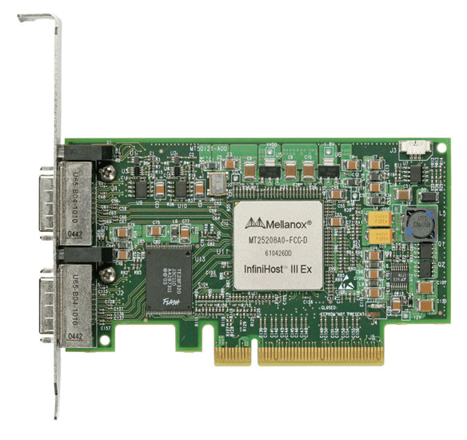
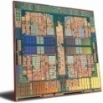
Background: MPI-3 RMA Memory Models
MPI-3 provides two memory models: SEPARATE and UNIFIED
MPI-2: SEPARATE model
Logical public and private copies
MPI provides software coherence between window copies
Extremely portable to systems that don’t provide hardware coherence
MPI-3: new UNIFIED model
Single copy of the window
System must provide coherence
Provides access to full performance potential of hardware
Public
Copy
Unified
Copy
Private
Copy
Notes:
SEPARATE window model: two copies
Public copy: shared memory in shared memory machines or main memory in distributed memory machines,
Private copy: fast buffers, local caches to each processes
Example: Intel SCC, NEC SX machine
UNIFIED model is a superset of SEPARATE model, since it allows concurrent local/remote access

Slide 45
Correctness Semantics
Interoperability
AM vs. RMA – RMA operations access “public” window, whereas AM handlers access “private” window
In SEPARATE window model, if AM and RMA, or AM and AM, or AM and STORE, update on the same window, even on non-overlapping locations, result data is undefined
AM write
PUT
AM write
public copy
Invalid operation combinations
private copies
STORE
Maintain memory consistency
In both SEPARATE and UNIFIED window models, MPI runtime should ensure the consistency of window
memory barrier
memory barrier
SEPARATE window model
AM handler
AM handler
UNIFIED window model
flush cache line back
memory barrier
memory barrier
Notes:
This difference cause some issues when AM works with RMA operations on the same window. Even for non-overlapping locations, data is undefined. (cache line, false-sharing)
=======================
SEPARATE window: flush cache line back to make private window and public window consistent
UNIFIED window: perform memory barrier to prevent instruction reordering
For separate window models, MPI implementation should flush the data back to memory after AM finishes, whereas for unified window model,
MPI implementation should call a full memory barrier after execution of AM to ensure future reads from window memory return the updated data.

Slide 46
Correctness Semantics (Cont’d)
Ordering
By default three orderings are imposed:
AMs with different operations
AMs with the same operation
Segments within one AM
when AMs are from same origin, to same target, update on same window and overlapping memory locations
All orderings can be released by user using MPI info hint for higher performance
origin
target
AM 1
AM 2
window
Concurrency
By default, MPI implementation is “as if” AMs are executed in some sequential order
If MPI implementation can know that concurrency is inconsequential, it can execute AMs concurrently (target data is non-overlapping)
Concurrency can be released by user using MPI assert for higher performance

Slide 47
Optimizing MPI-AM for Different Application Scenarios
Identify “exclusive” user buffers to reduce hand-shake operations
Auto-detected: only one hand-shake operation is required after exclusive MPI_WIN_LOCK or MPI_WIN_FLUSH
User-defined: if user defines certain amount of user buffers provided on target when creating window, no hand-shake operation is required
origin
target
process 0
process 1
process 2
Win_create
Win_create
Win_create
Win_lock
rank
size
0
20 MB
hand shake
Win_fence
2
30 MB
Win_fence
AM 1
AM 1
AM 1
AM 2
AM 2
AM 3
AM 2
Win_unlock
Win_fence
Win_fence
AM
Efficient data transmission
“v” version of AM Trigger: return vector containing actual counts in each output segment
Reduce data amount being transferred
Application can get more accurate information of output segments
pipeline unit #1
pipeline unit #2
segment #1
segment #2
segment #3
segment #4
pack
pack
unpack
unpack
segment #1
segment #2
segment #3
segment #4

Slide 48
Asynchronous Processing in MPI-AM
Three execution models
Non-Async: no asynchronous processing, messages are processed by single thread (AM++, AMMPI)
Thread-Async: Asynchronous processing is provided by thread on top of MPI library (AM++, AMMPI)
Integrated-Async: Asynchronous processing is supported internally from MPI library (MPI-AM)
Asynchronous processing is supported internally from MPI runtime
Inter-node messages: spawn a thread in network module
Intra-node messages: “origin computation”
Processes on the same node allocate a shared-memory region
Shared-memory
NODE 0
NODE 1
Network
rank 1 (origin)
rank 0 (target)
rank 2 (origin)

Slide 49
Microbenchmark Emulating DNA Sequencing
Effect of message streaming[*]
Effect of message buffering[*]
[*] Run on “Blues” at ANL: 310 nodes, 64GB memory per node, 16 cores per node, QLogic QDR interconnect

Slide 50
Microbenchmark Emulating DNA Sequencing (Cont’d)
Effect of different semantic configurations[*]
Effect of exclusive user buffers[*]
[*] Run on “Blues” at ANL: 310 nodes, 64GB memory per node, 16 cores per node, QLogic QDR interconnect

Slide 51
Microbenchmark Emulating DNA Sequencing (Cont’d)
Advantage of “v” version of AM trigger[*]
Overlapping effects of asynchronous processing[#]
inter-node
intra-node
[*] Run on “Blues” at ANL: 310 nodes, 64GB memory per node, 16 cores per node, QLogic QDR interconnect
[#] Run on “Fusion” at ANL: 320 nodes, 36GB memory per node, 8 cores per node, Mellanox InfiniBand QDR interconnect

Slide 52
Evaluation with Graph 500 Benchmark[*]
Comparison
Default-g500: default implementation
DDT-g500: coalescing messages using derived data type (DDT)
AM-g500: coalescing messages using Active messages
[*] Run on “Fusion” at ANL: 320 nodes, 36GB memory per node, 8 cores per node, Mellanox InfiniBand QDR interconnect

Slide 53
Main Contributions
Improvements from MPI runtime for irregular applications
Identify scalability limitations in existing MPI RMA runtime when running with irregular applications
Propose a new MPI RMA runtime, ScalaRMA, to tackle scalability challenges in window creation, synchronization algorithms and implementation of data movement operations, including algorithmic changes and resource management strategy
Improvements from MPI standard for data-driven computations
Message streaming
Buffer management
Correctness semantics
Optimization for different application scenarios
Asynchronous processing

Slide 54
Publication Related to Thesis Work
1. [submitted to ICS 2016] Addressing Scalability Limitations in MPI One-Sided Communication. Xin Zhao, Pavan Balaji, William Gropp.
2. [CCGrid 2015 Doctoral Symposium] Runtime Support for Irregular Computation in MPI-Based Applications. Xin Zhao, Pavan Balaji, William Gropp.
3. [SC 2014] Nonblocking Epochs in MPI One-Sided Communication. Judicael Zounmevo, Xin Zhao, Pavan Balaji, William Gropp, Ahmad Afsahi. Best Paper Finalist.
4. [ScalCom 2013] Optimization Strategies for MPI-Interoperable Active Messages. Xin Zhao, Pavan Balaji, William Gropp, Rajeev Thakur. Best Paper Award.
5. [ICPADS 2013] MPI-Interoperable Generalized Active Messages. Xin Zhao, Pavan Balaji, William Gropp, Rajeev Thakur.
6. [CCGrid 2013] Towards Asynchronous and MPI-Interoperable Active Messages. Xin Zhao, Darius Buntinas, Judicael Zounmevo, James Dinan, David Goodell, Pavan Balaji, Rajeev Thakur, Ahmad Afsahi, William Gropp.
7. [Master Thesis] Adaptive Strategy for One-Sided Communication in MPICH2. Xin Zhao.
8. [EuroMPI 2012] Adaptive Strategy for One-sided Communication in MPICH2. Xin Zhao, Gopalakrishnan Santhanaraman, William Gropp.
9. [EuroMPI 2011] Scalable Memory Use in MPI: A Case Study with MPICH2. David Goodell, William Gropp, Xin Zhao, Rajeev Thakur.

Slide 55
Questions?

Slide 56
Backup Slides

Slide 57
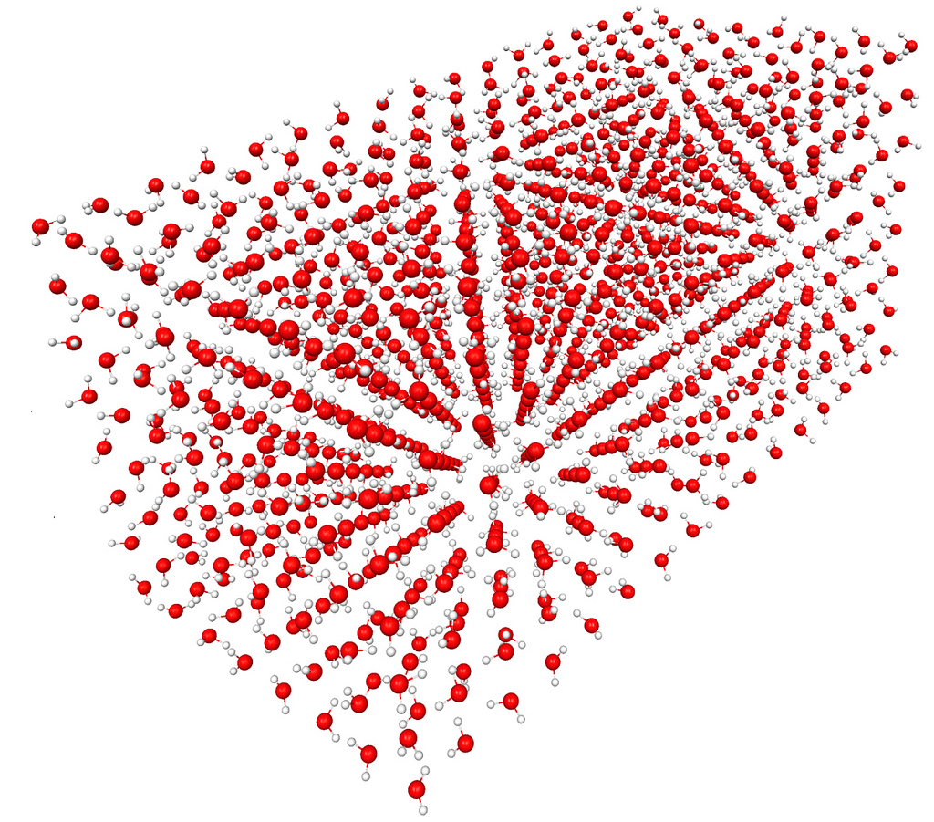
N-Body Coulomb Interactions
interactions among ~20 water molecules
Current applications have been looking at small-to-medium molecules consisting of 20-100 atoms
Amount of computation per data element is reasonably large, so scientists have been reasonably successful decoupling computation and data movement
For Exascale systems, scientists want to study molecules of the order of a 1000 atoms or larger
Coulomb interactions between the atoms is much stronger in the problems today than what we expect for Exascale-level problems
Larger problems will need to support both short-range and long-range components of the coulomb interactions (possibly using different solvers)
Diversity in the amount of computation per data element is going to increase substantially
Regularity of data and/or computation would be substantially different
interactions among ~1000 water molecules

Slide 58
Traditional Coulomb Interactions are Near-Sighted
Traditional quantum chemistry studies (small-to-medium molecules) lie within the near-sighted range where interactions are dense
interaction strength
short-range
Range of interactions between particles
long-range
distance
Future quantum chemistry studies (larger molecules) expose both short-range and long-range interactions
(Note that the figures are phenomenological. Quantum chemistry methods treat correlation using a variety of approaches and have different short/long-range cutoffs.)
Courtesy Jeff Hammond (Intel Corp.)

Slide 59
State-of-the-Art: Operation Metadata
Metadata needs to be maintained for each operation
not issued
Operation states | Metadata
 | Issuing parameters (stored in operation objects) | States for local completion (stored in requests) | States for remote completion (stored in target objects)
Not issued | ✓ | ✓ | ✓
Partially issued | ✓ | ✓ | ✓
Fully issued | ✗ | ✓ | ✓
Locally completed | ✗ | ✗ | ✓
Remotely completed | ✗ | ✗ | ✗
synchronization is finished
YES
is it a streamed OP?
NO
partially issued
all units are issued
fully issued
local completion detected
locally completed
YES
is it a write OP?
NO
remote completion detected
remotely completed

